Slide 1
I-502 Data Analysis
Choosing a Testing Lab for Grow Op Farms

Slide 2
Table of Contents
01
02
03
04
Question
Data
Results
Appendix

Slide 3
1
Question

Slide 4

Grow Op Farms wants to know what testing lab to send their material to, to optimize for THC %.
Grow Op Farms
99 PROBLEMS AND A STRAIN AIN'T ONE

Slide 5
2
Data

Slide 6
I-502 Public Data
5,422
3,321
Lab results from Green Grower Labs.
Lab tests sent by Grow Op Farms.
2,101
Lab results from Praxis Laboratory.

Slide 7
3
Results

Slide 8
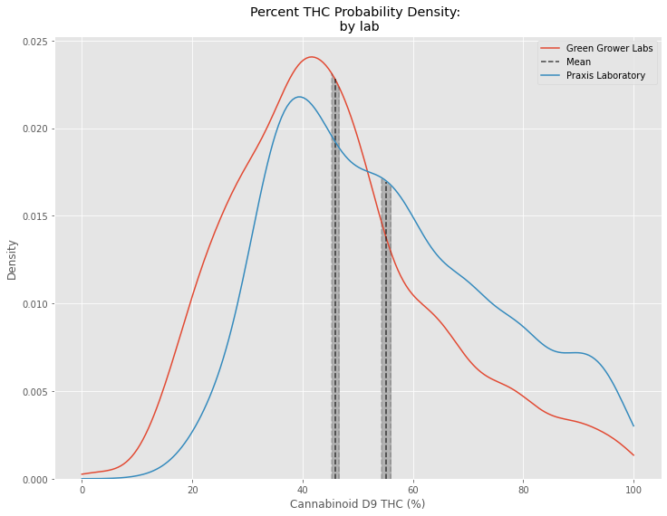
Key Takeaways:
Not Normal
  No transformation made Praxis Lab’s probability density distribution normal
Praxis Labs is the better choice
  Confirmed with Mann Whitney

Slide 9
Product Overview

Slide 10
4
Analysis
You can enter a subtitle here if you need it

Slide 11
More Important Numbers
15,000
78,000
Mars is actually a cold place
Saturn has several rings

Slide 12
Business Percentages
50%
30%
25%
80%
Marketing
Training
Assessment
Technology
Despite being red, Mars is a cold place
Venus has a
beautiful name
It’s a giant and the biggest planet
It’s the closest planet to the Sun

Slide 13
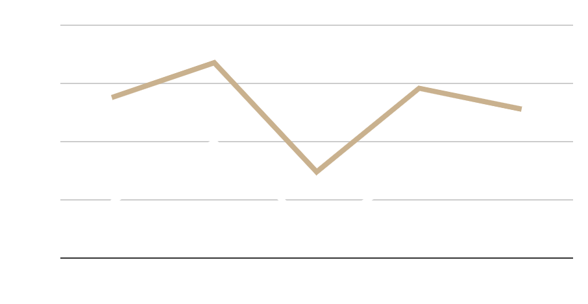
Business Traction
67.0 %
Jupiter is the biggest planet
33.0 %
Mars is actually a cold place
To modify this graph, click on it, follow the link, change the data and paste the new graph here

Slide 14
Thank You
Do you have any questions? youremail@freepik.com
+91 620 421 838
yourcompany.com
Please keep this slide for attribution

